Slide 1
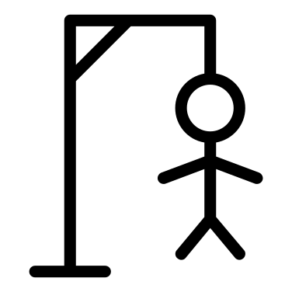
HANGMAN
By- Aashvi Chawla, 2210990019
Submitted to: Tushar Khitoliya
G-10

Slide 2
_ | | | |__ __ _ _ __ __ _ _ __ ___ __ _ _ __ | '_ \ / _ ‘ | ‘ _ \ / _ ` | '_ ` _ \ / _` | '_ \ | | | | (_| | | | | (_| | | | | | | (_| | | | | |_ | |_ |\__,_|_| |_|\__, |_ | |_| |_|\ __,_|_ | |_| __ / | | ___ /

Slide 3
AGENDA
Introduction
Features
How to play
Program functions
Variables
Resources
Summary

Slide 4
Introduction
This a simple word guessing game , in which the program will present the player with a word whose letters are blanked out, and the player will then have to guess what the word is correctly. A wrong guess would result in the player's avatar in the game, a stick figure, getting closer and closer to be 'hanged'. Hence, the eponymous name of the game.
Unlike the pen-and-paper version however, this Android Hangman lacks the ability to come up with new words, and thus is somewhat limited in the sense that the words 'questioned' are all hard-coded into the program itself.

Slide 5
HOW TO PLAY
🌟It’s a simple Hangman game.
🌟The program will choose a secret word at random.
🌟The player has to guess the letters in the word.
🌟Player will be given two hints for each word.
🌟Lives will be deducted everytime he guesses the wrong letter.
🌟Either the player guesses the word or he gets hanged.
🌟The correct word will be displayed after the man gets hanged.
🌟Loop will continue and you can try again with another word.

Slide 6
PROGRAM FUNCTIONS
❄️def start()
❄️def randstart()
❄️def main()
❄️def play_loop()
❄️def hangman()

Slide 7
VARIABLES
♠️global count
♠️global display
♠️global word
♠️global already_guessed
♠️global length
♠️global play_game
♠️global g

Slide 8


Salient features
Hangman art
Double hints
User friendly
Internet free
RANDOM WORD
Every time user inputs a wrong letter, man proceeds to hang.
After two wrong inputs, user gets another hint for the word.
The game is really easy to catch.
You can get access to this game even without internet.
An endless dictionary of random words

Slide 9
SUMMARY
Hangman is a simple word guessing game where the player attempts to build a missing word by guessing one letter at a time. After a certain number of incorrect guesses, the game ends and the player loses. The player will get two hints for reaching the correct word, one at the beginning and other after two wrong inputs.
Development Language - Python

Slide 10
resources
web
Hangman game

Slide 11
THANK YOU

